Slide 1
Microservices with EAP6
Jim Ma

Slide 2
About Me
Apache CXF committer/CXF PMC member
JBoss-WS committer
JBossESB, JBPM, RHQ,Wise Contributor
JBoss AS7/Wildfly core developer
docker,kubernetes, mircoservices learner
weibo: @jimmaCN

Slide 3
Agenda
Mircoserviecs
JEE Architecture evolves to Mircoservices
Demo

Slide 4
Microservices
Software architectural style that combines a mixture of well-established and modern patterns and technologies to achieve a number of desirable goals
Applications are developed as a suite of small services, each running as an independent process in its own logical machine 1 (or Linux container)
Services are built around capabilities 2 : single responsibility principle
One can independently replace / upgrade / scale / deploy services
Standard lightweight communication is used, often REST calls over HTTP
Potentially heterogeneous environments are supported

Slide 5
Pros
Faster and simpler deployment and rollback with smaller services.
Not sharing the same deployment platform with other services allows each service to be scaled out as needed.
Selecting the right tool, language and technology per service, without having to conform to a homogeneous environment being dictated by shared infrastructure
Fault isolation at microservice level by shielding services from common infrastructure failure due to the fault of one service.
Well-suited for Continuous Delivery and Integration
Promotes DevOps culture with higher service self-containment and less common infrastructure maintenance.

Slide 6
Cons
Less tooling / IDE support given the distributed nature.
QA, particularly integration testing can be difficult.
Debugging is always more difficult for distributed systems.
Higher complexity – higher fixed cost and overhead.
Heterogenous environments are difficult and costly to maintain.

Slide 7
Think before Mircoservices...
Are you comfortable on the cutting edge of technology?
Can you adapt your staffing to DevOps？
How skilled are you at troubleshooting system errors
Can you afford higher up-front costs?
Do you have a network that can support the architecture?

Slide 8
MicroService requires you to pay more attention :
Security(keycloak)
Monitor&Management
Cache
LoadBalancer
Service Discovery

Slide 9
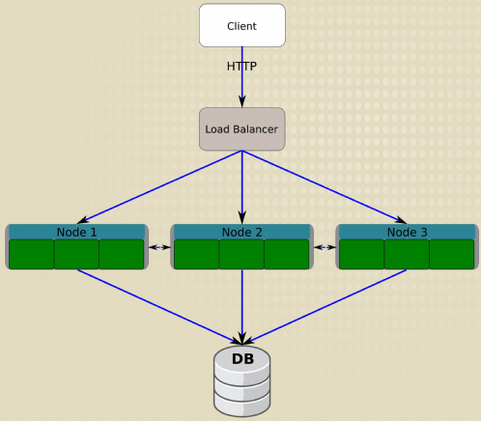
JEE Architecture evolves to Mircoservices
No service concept

Slide 10
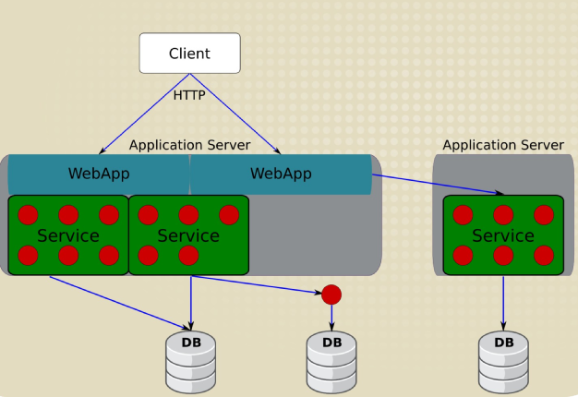
JEE Architecture evolves to Mircoservices
Single node failure

Slide 11
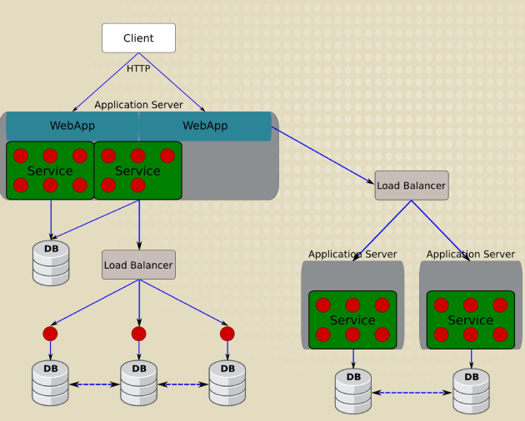
JEE architecture evolves to Mircoservices

Slide 12
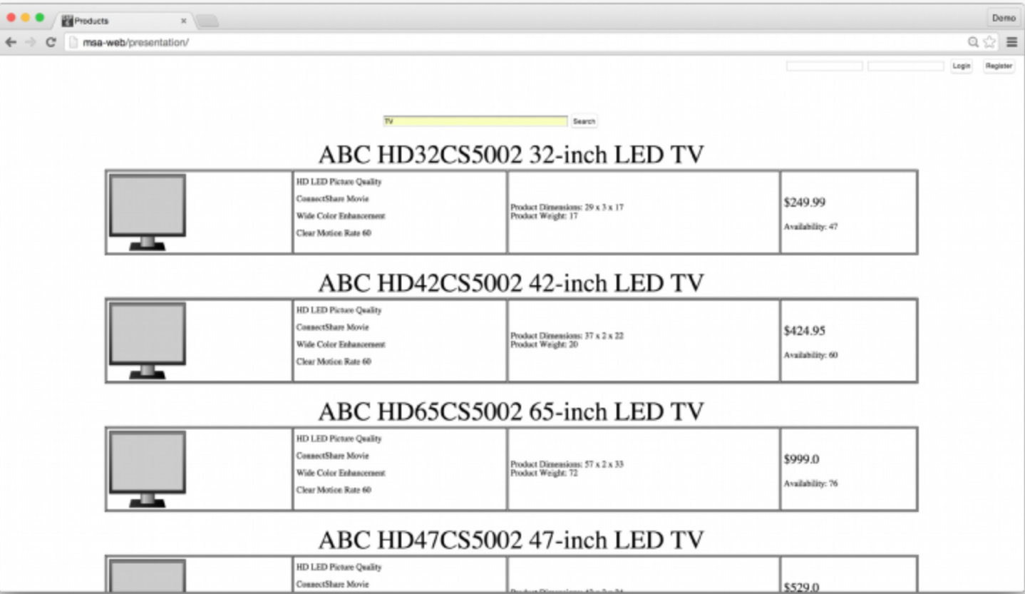
Dmoe-online store

Slide 13
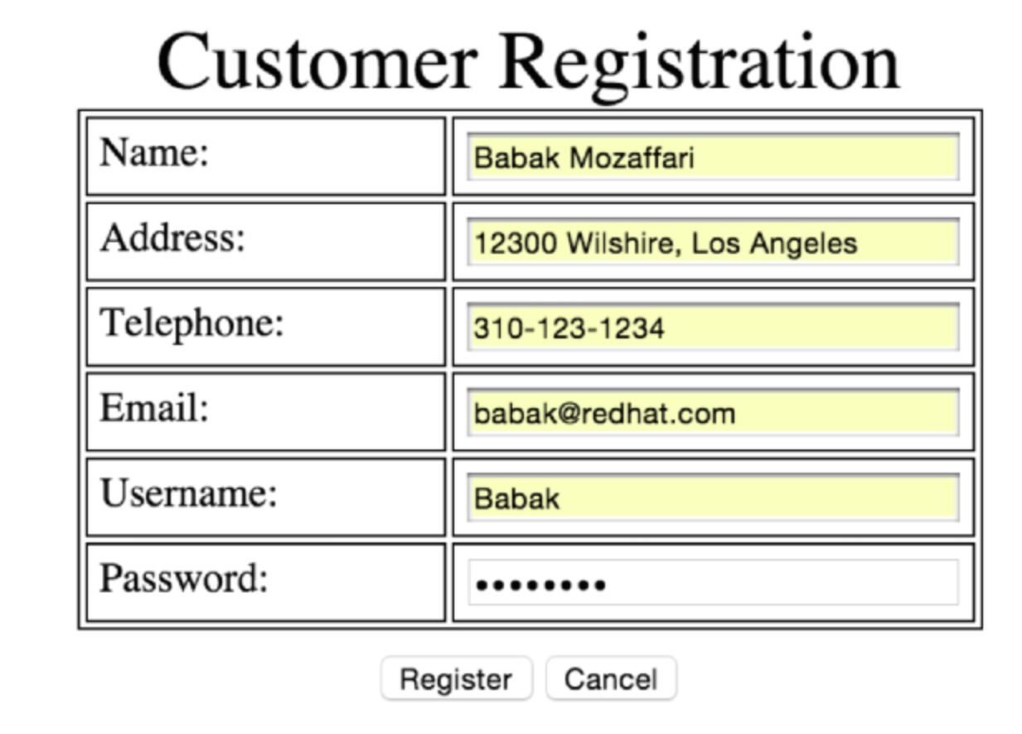
Demo-Registration

Slide 14
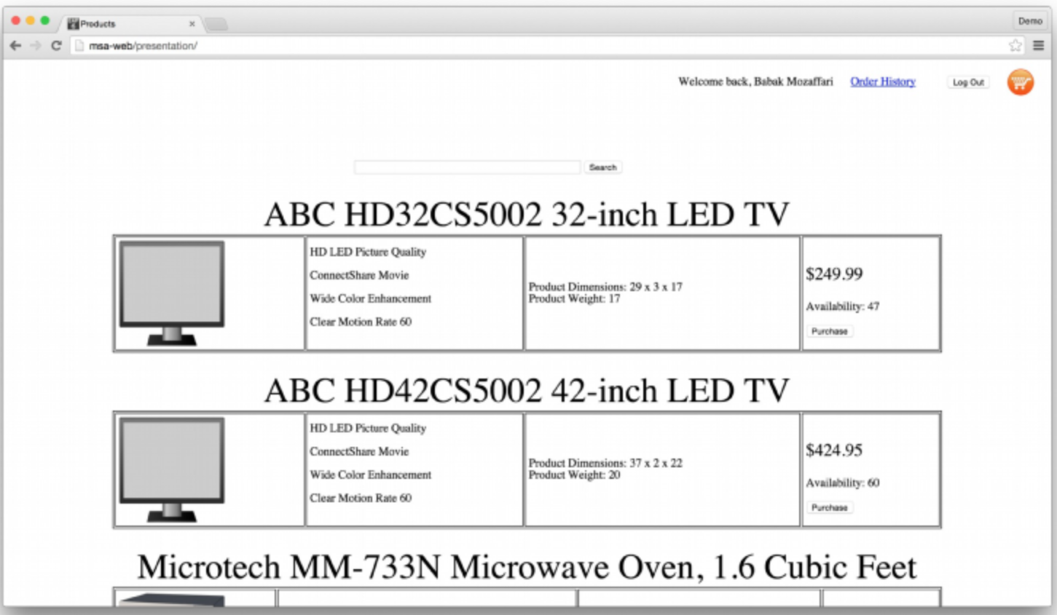
Demo-Login

Slide 15
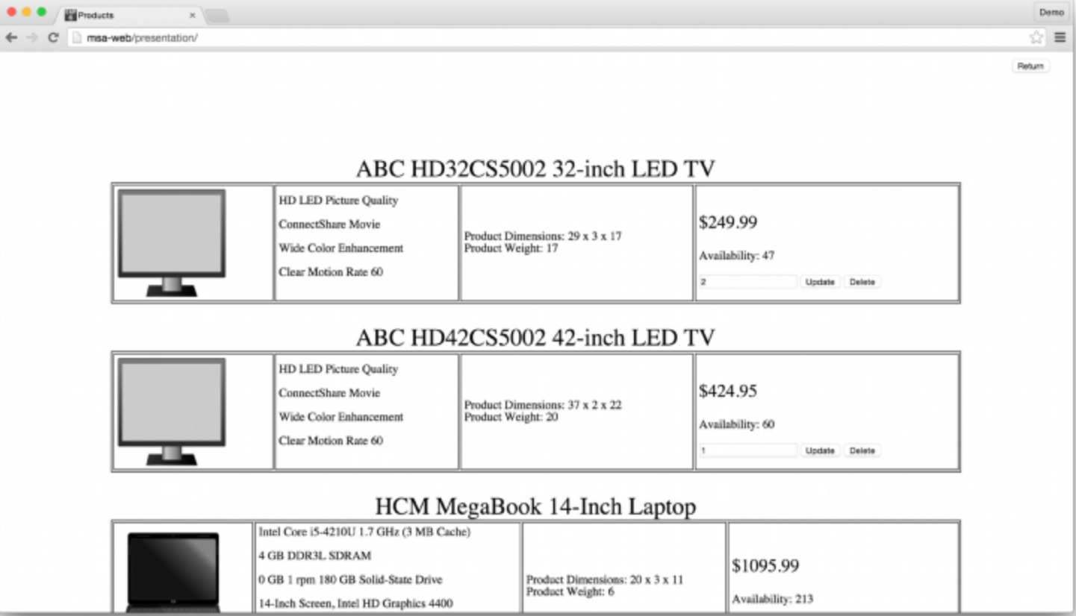
Demo-Cart

Slide 16
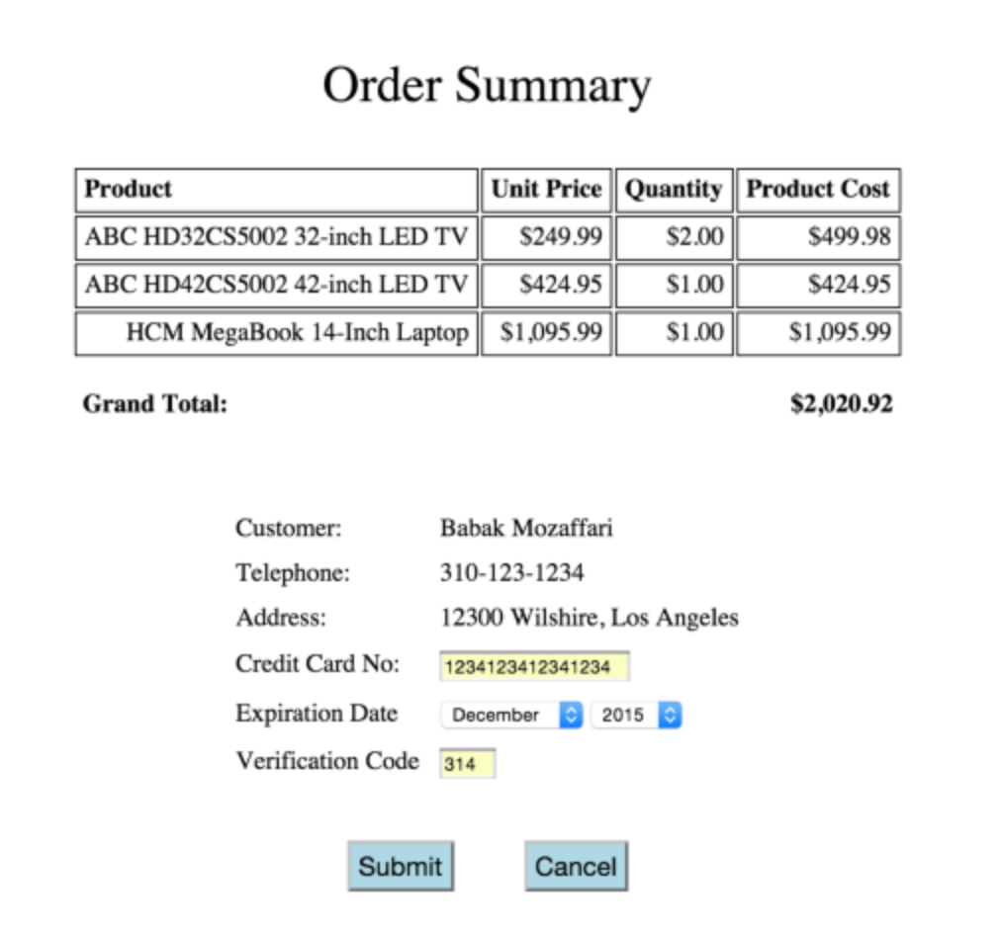
Demo-Checkout

Slide 17
OnlineStore MircroService Design
PresentationLayer:frontend ui to call the backend service (code/Presentation/target/presentation.war)
Product service: provide all restful api about stock product:for example list, search detail info (code/Product/target/product.war)
Sales service: provide user register, login, cart, order restful api (code/Sales/target/sales.war)
Billing Service：provide checkout and payment restful api for customer's order (code/Billing/target/billing.war)

Slide 18
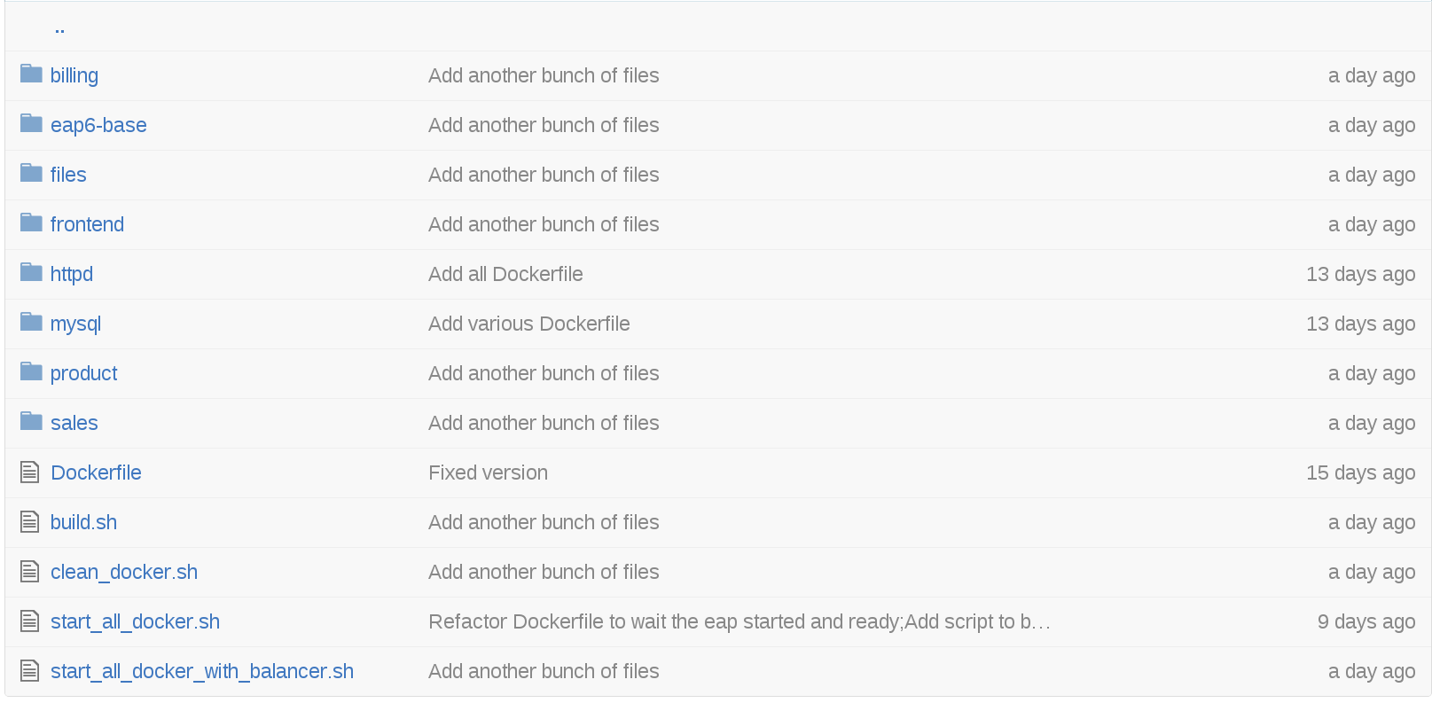
Docker Image

Slide 19
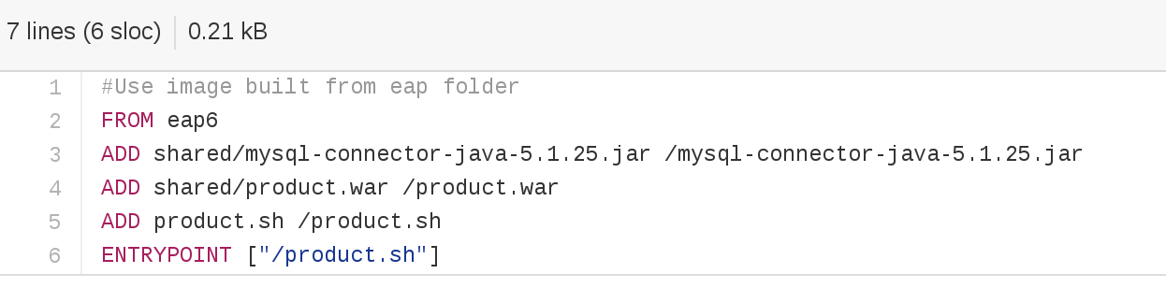
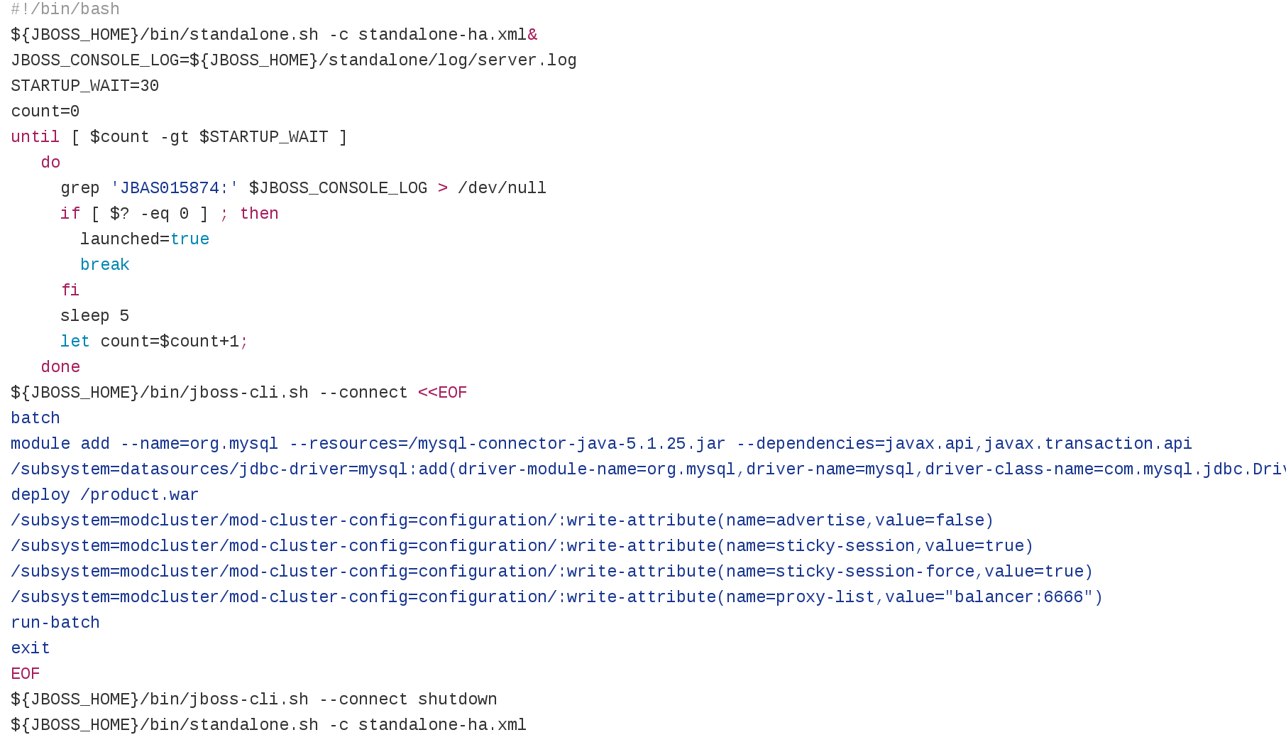
Dockerfile

Slide 20
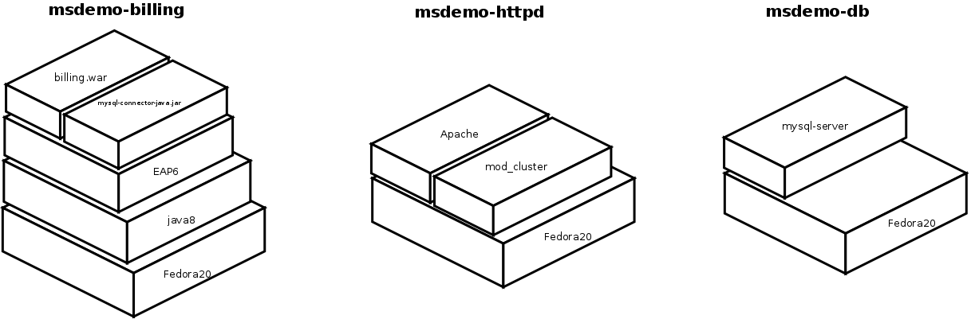
Docker images layer

Slide 21
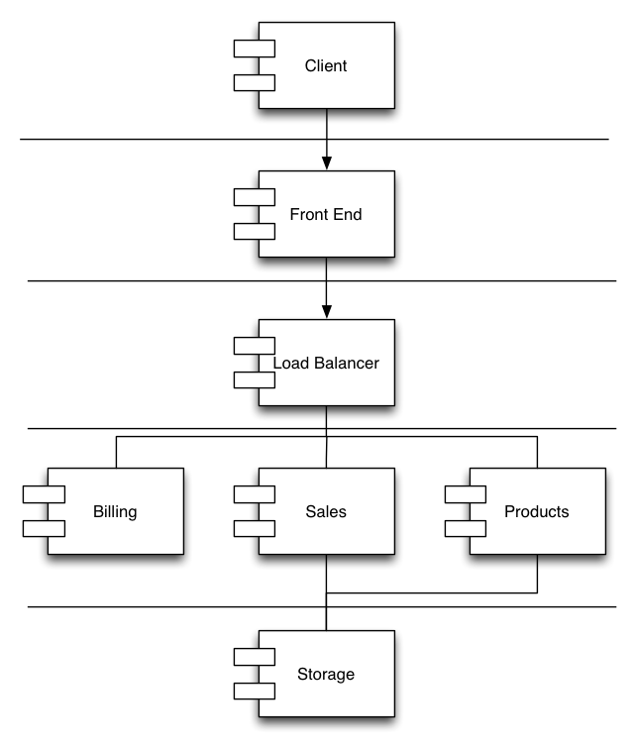
Mircoservice deployment

Slide 22
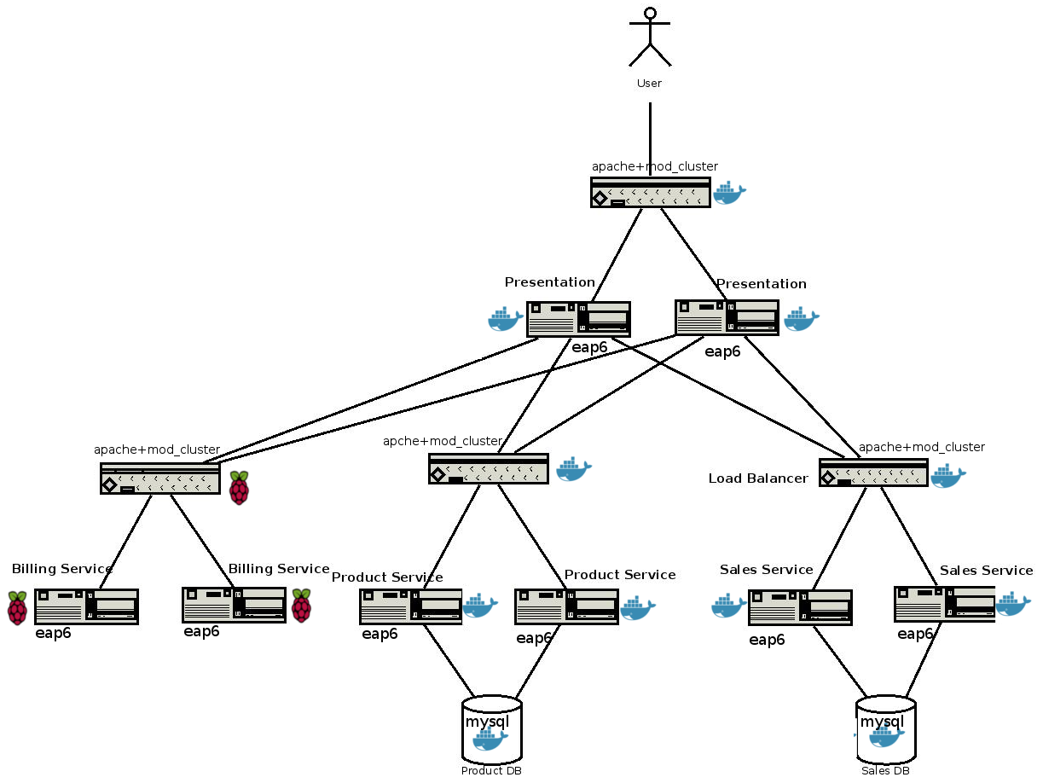
A more complex Mircoservice deployment with Pis

Slide 23
Reproduce with these steps
Git clone: https://github.com/bgeorges/microservices
Install and start docker service
Go to docker
Run build.sh build all docker images
Run all docker containers with start_all_docker.sh

